Slide 1
Cross-Formalism Decomposition of DEVS Coupled Models
Neal DeBuhr and Dr. Hessam Sarjoughian

Slide 2
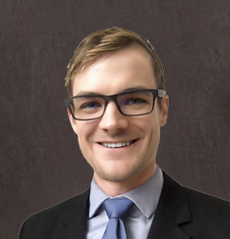
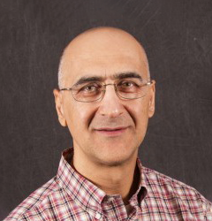
Authors
Neal DeBuhr
Hessam Sarjoughian

Slide 3
Cross-Formalism Model Decomposition

Slide 4
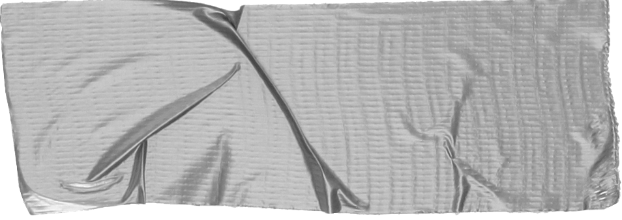
Contents
Context Introduction and background.
Cross-Formalism Decomposition Concepts and mechanics.
Impact Results and future considerations.

Slide 5
Contents
Context Introduction and background.
Cross-Formalism Decomposition Concepts and mechanics.
Impact Results and future considerations.

Slide 6
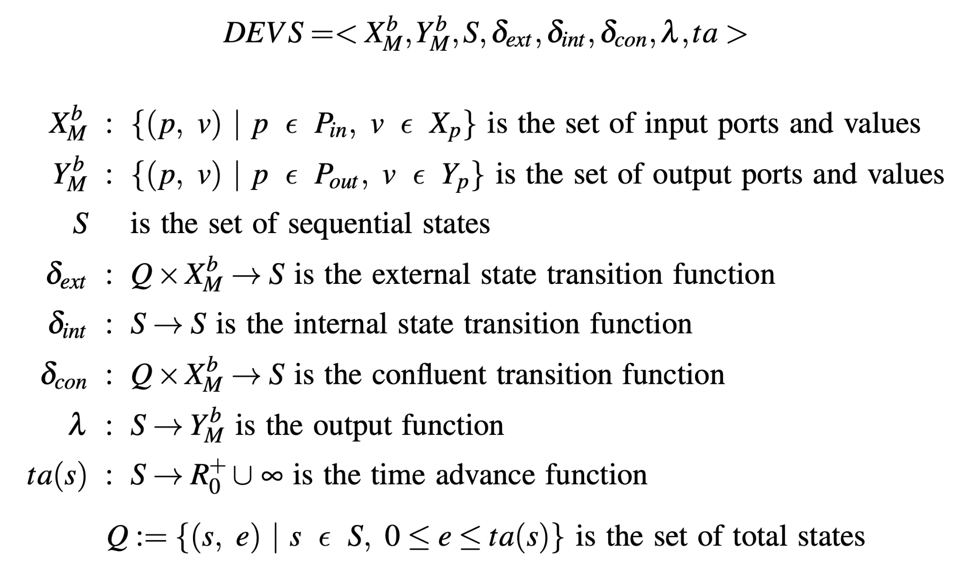
Discrete EVent
System
Specification

Slide 7
DEVS Hierarchical Modeling

Slide 8
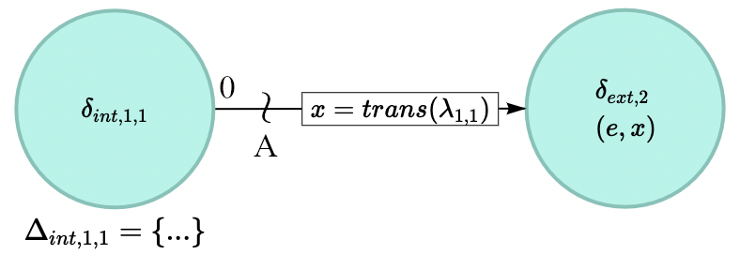
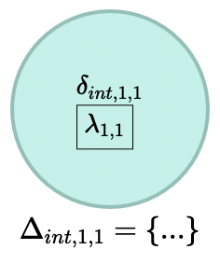
Event Graphs
Notes:
Elaboration to clarify
Especially the bottom one could be tricky (even for DEVS-familiar folks)

Slide 9
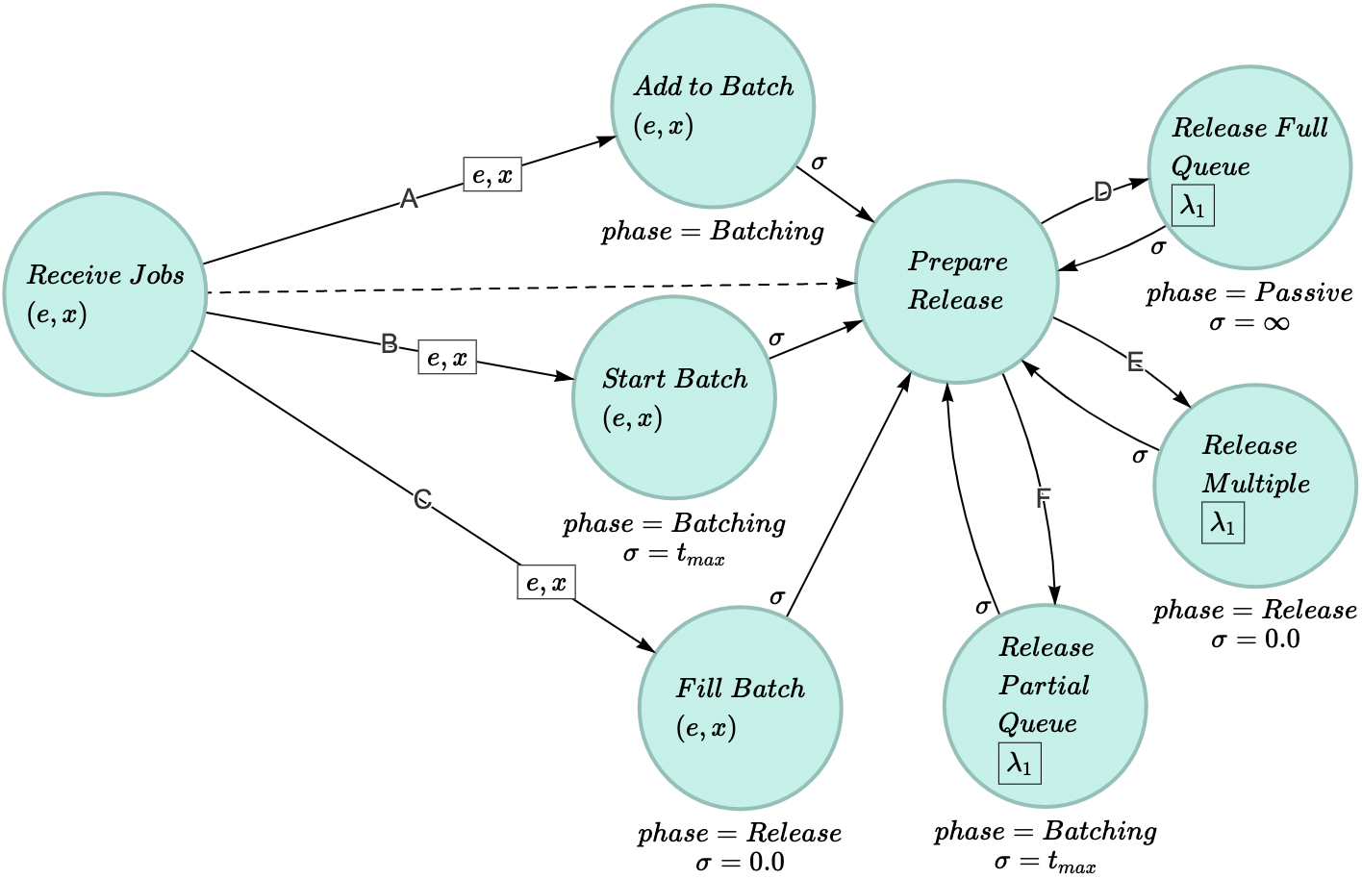
Event Graphs

Slide 10
Example Model
Max batching time is reached
A max bax size is reached before the max batching time is reached
Even with simultaneous arrivals, the max batch size is not exceeded

Slide 11
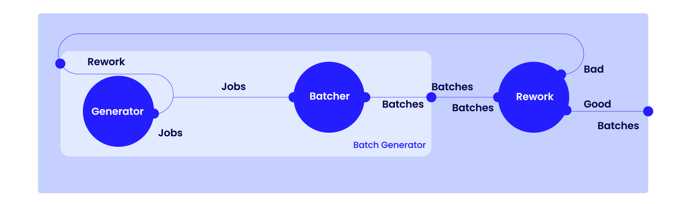
Example Model

Slide 12
Contents
Context Introduction and background.
Cross-Formalism Decomposition Concepts and mechanics.
Impact Results and future considerations.

Slide 13
Transformation
Recursive flattening of all DEVS coupled models, such that all coupled models are iteratively decomposed to atomic models and couplings
Transformation of every DEVS atomic model to its respective event graph representation (herein referred to as event clusters, to distinguish them from the event graph of the entire system)
Transformation of internal (endogenous) and external (exogenous) I/O coupling structures

Slide 14
Recursive
Decomposition

Slide 15
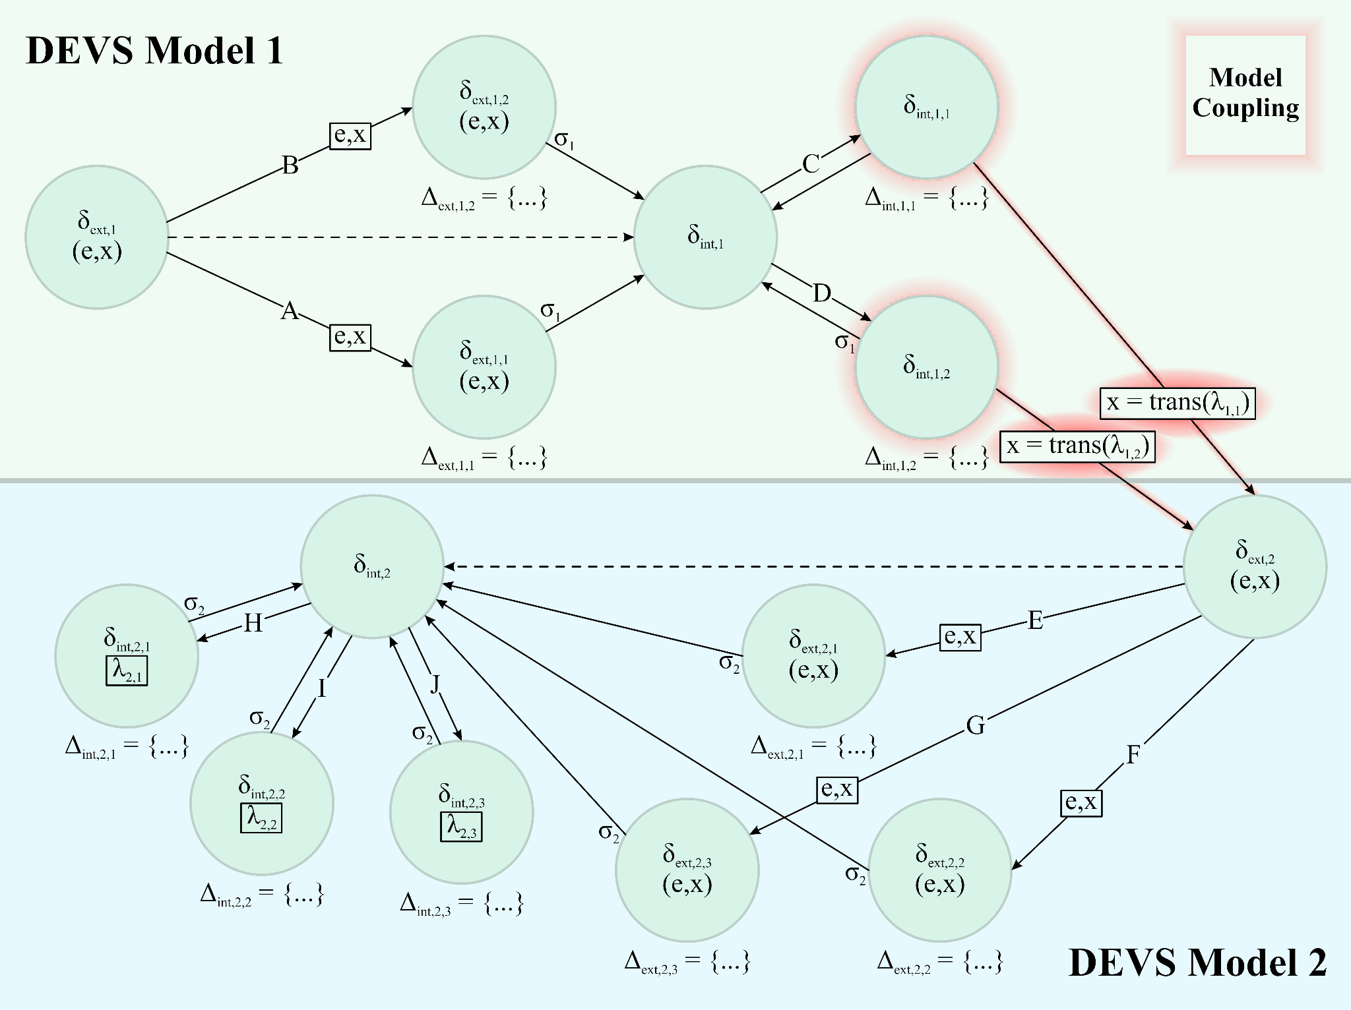
Event Clusters, Ports, and
Couplings

Slide 16
Contents
Context Introduction and background.
Cross-Formalism Decomposition Concepts and mechanics.
Impact Results and future considerations.

Slide 17
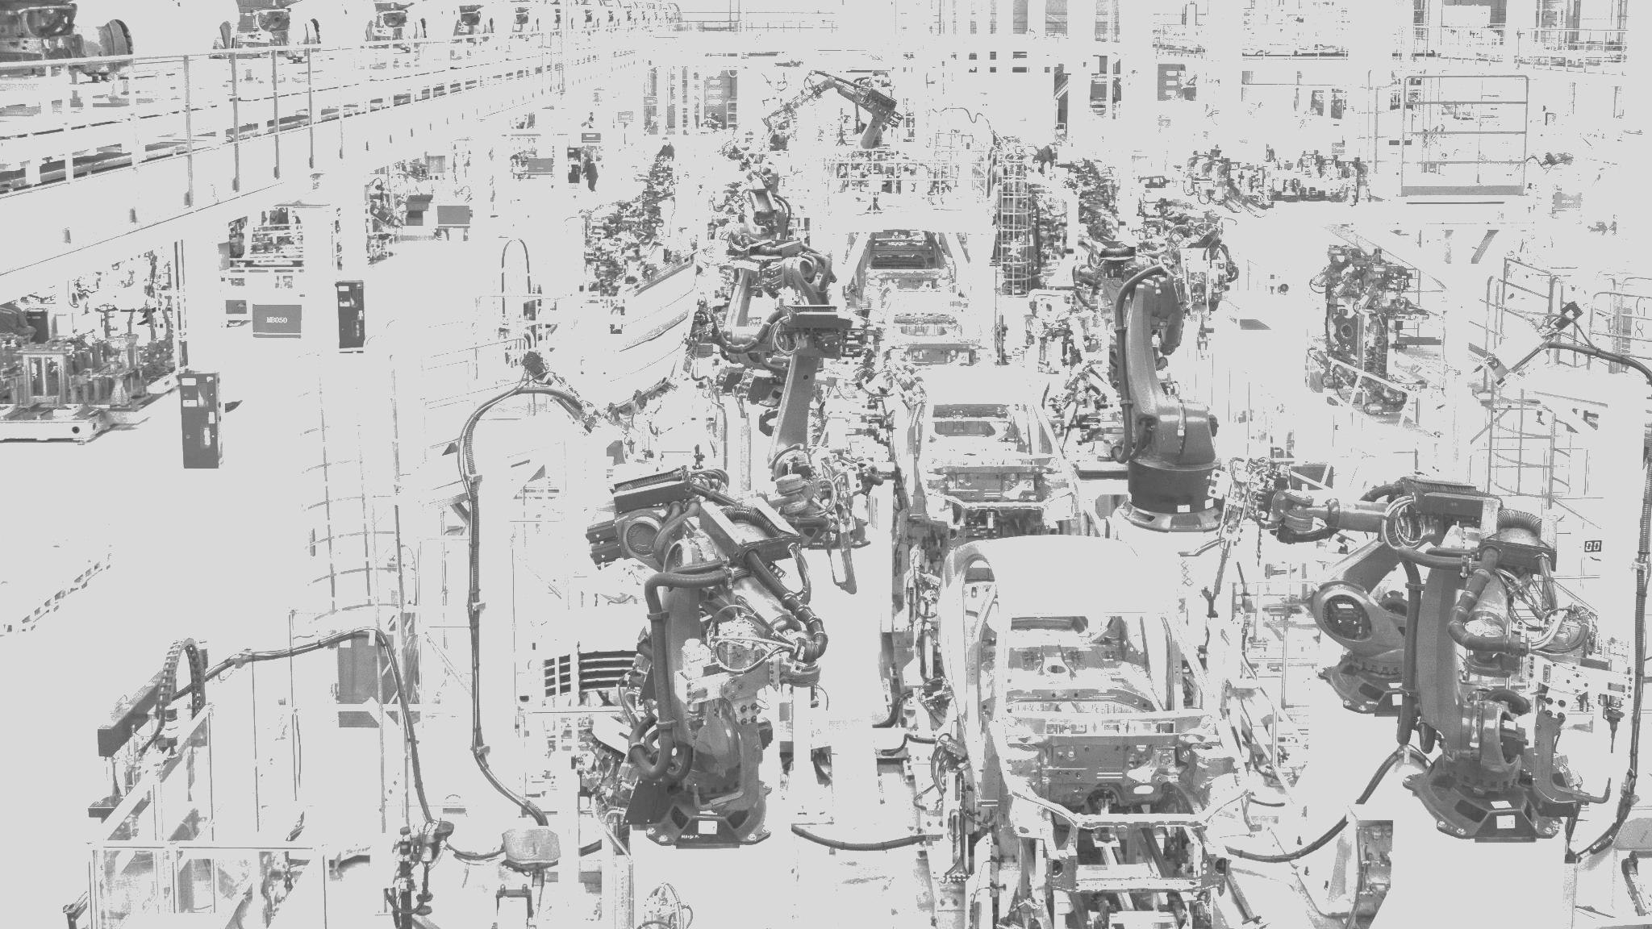
Results

Slide 18
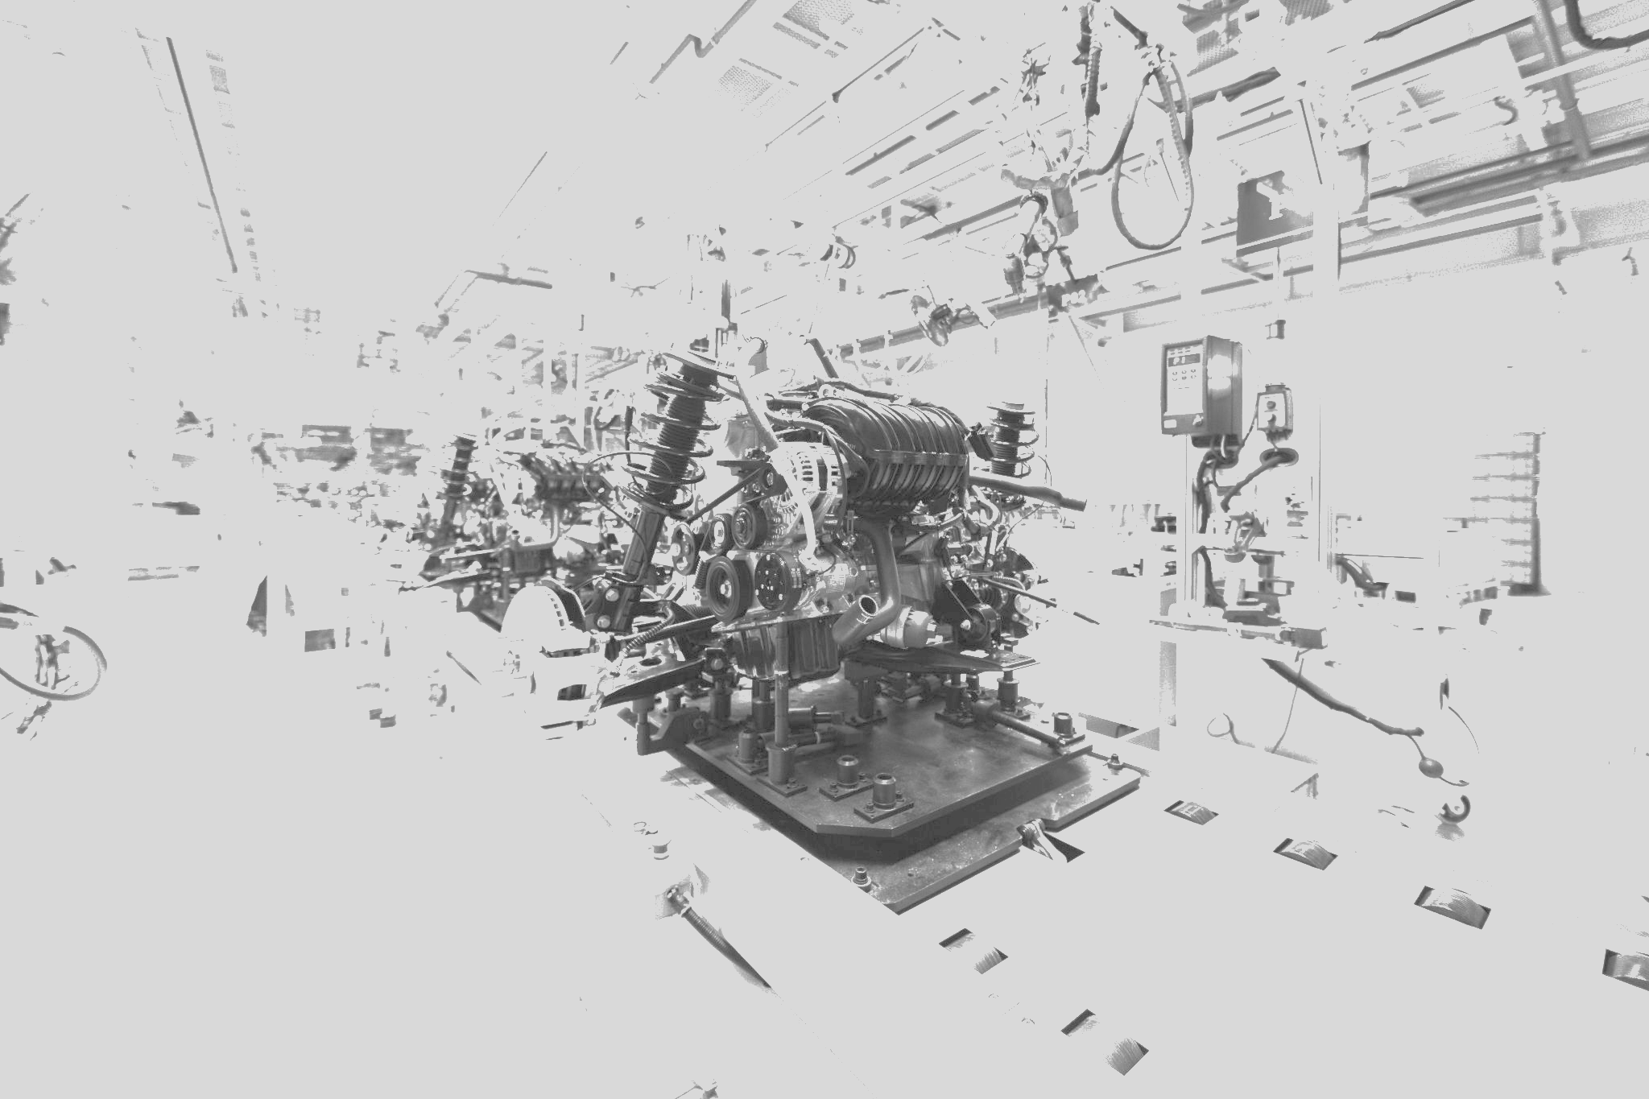
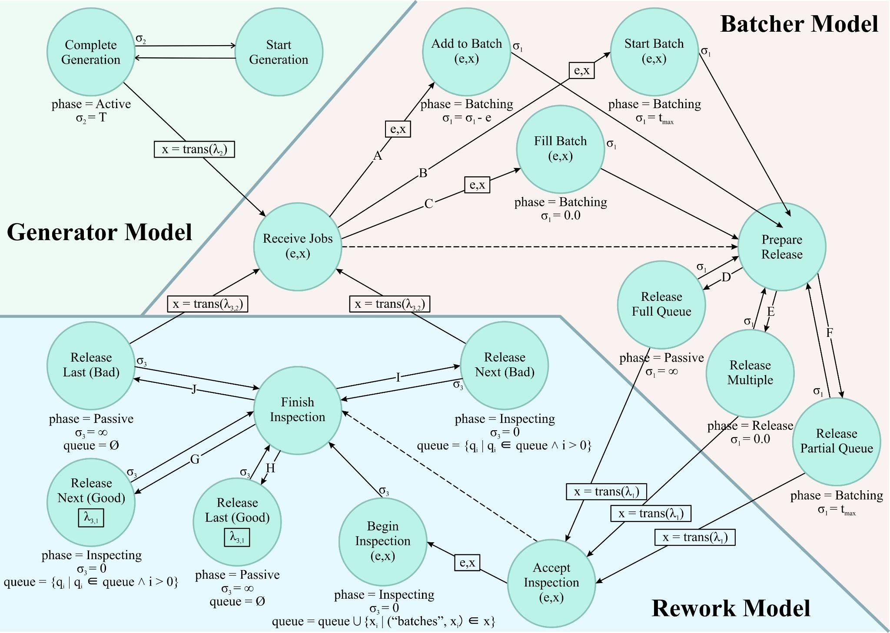
Results

Slide 19
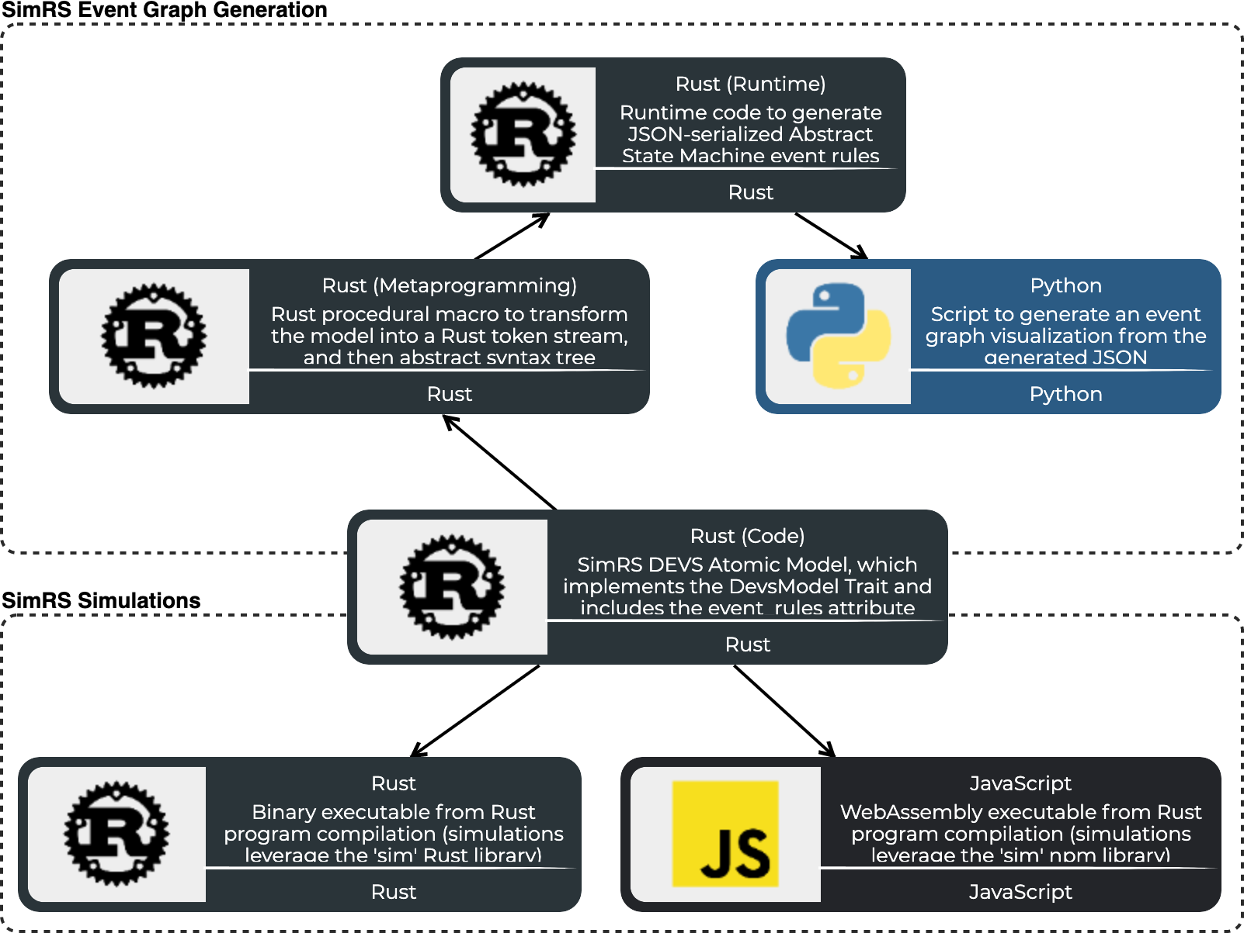
In Software

Slide 20
In Software

Slide 21
Future Considerations
Research into simulation project soft factors
Model reasoning
Collaboration
Communication,
Implications on performance and scalability of simulations
Design of cross-formalism simulators and simulation projects
Frameworks for hierarchical event graph models

Slide 22
Thank You

Slide 23
Ports, Couplings, and Attributes
Notes:
How to interpret, especially relative with atomic vs. coupled
This is pretty hard to follow

